Slide 1
Employee Data Analysis using Excel
STUDENT NAME: SHRUTHI SS
REGISTER NO: 3ADBEF2D985F47D9BE34644F97A5C526,312208808
DEPARTMENT: B.COM (GENERAL)
COLLEGE: MEENAKSHI COLLEGE FOR WOMEN

Slide 2
PROJECT TITLE:
Male employee type, Department, FTE, Salary Analysis using Excel

Slide 3


AGENDA:
Project Overview
End Users
Our Solution and Proposition
Dataset Description
Problem Statement
Modelling Approach
Results and Discussion
Conclusion
3/21/2024 Annual Review

Slide 4

PROBLEM STATEMENT:
The purpose of Full-Time Equivalent (FTE) is to standardize the measurement of employee work hours, regardless of whether they work full-time or part-time, in order to better manage, allocate, and analyze workforce resources.

Slide 5

PROJECT OVERVIEW:
.
Employee analysis involves examining various aspects of the workforce to gain insights that can help in decision - making, improving efficiency, and enhancing employee satisfaction.

Slide 6

WHO ARE THE END USERS?
HUMAN RESOURCE DEPARTMENTS
MANAGEMENT AND LEADERSHIP
TEAM LEADERS AND SUPERVISORS
EMPLOYEES
EXECUTIVE LEADERSHIP
BUSINESS ANALYSTS
RECRUITERS

Slide 7

OUR SOLUTION AND ITS VALUE PROPOSITION:
FILTERING- REMOVE VALUES
PIVOT TABLE - SUMMARY OF EMPLOYEE PERFORMANCE
BAR DIAGRAM - FINAL REPORT

Slide 8
Dataset Description:
EMPLOYEE DATA SET- NAN MUDHALVAN PORTAL
9 FEATURES IN EXCEL:
EMPLOYEE ID- ALPHANUMERIC(TEXT)
NAME- ALPHABETICAL(TEXT)
GENDER- ALPHABETICAL(TEXT)
DEPARTMENT - ALPHABETICAL(TEXT)
SALARY - NUMERICAL
START DATE - ALPHANUMERIC(TEXT)
FTE- NUMERICAL
EMPLOYEE TYPE- ALPHABETICAL(TEXT)
EMPLOYEE LOCATION- ALPHABETICAL(TEXT)

Slide 9
3 FEATURES USED:
DEPARTMENT - ALPHABETICAL(TEXT)
FTE- NUMERICAL
EMPLOYEE TYPE- ALPHABETICAL(TEXT)

Slide 10

THE "WOW" IN OUR SOLUTION:
Effective data visualization makes it easier to present complex data in an engaging and understandable way.
Well-presented data can have a significant impact on decision-makers, helping to drive change and innovation.
3/21/2024 Annual Review
10

Slide 11
MODELLING:
STEP -1
DOWNLOAD THE EMPLOYEE DATASET AND OPEN THE EMPLOYEE DATASET IN EXCEL.
STEP -2
SELECT THE ENTIRE DATA AND CLICK ON DATA AND CLICK ON FILTER OPTION.
STEP -3
FILTER FTE FROM A TO Z ORDER.
STEP -4
SELECT THE ENTIRE DATA AND CLICK ON INSERT AND CLICK ON PIVOT TABLE TO CREATE PIVOT TABLE.
11

Slide 12
STEP -5
DRAG THE NEEDED DATA AND CREATE A PIVOT TABLE.
STEP -6
SELECT THE PIVOT TABLE AND CLICK ON INSERT.
STEP-7
NOW CLICK ON THE CHART THAT YOU WANT.
STEP -8
THE CHART IS CREATED.

Slide 13
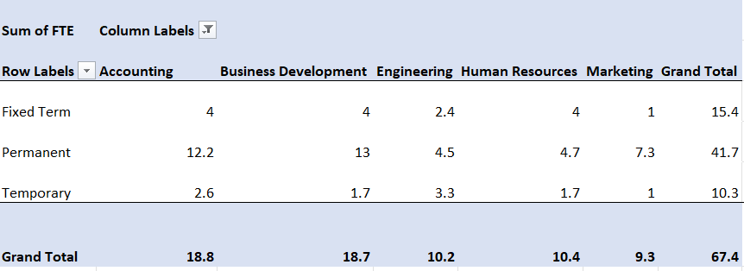
RESULTS:
1.TABLE:
13

Slide 14
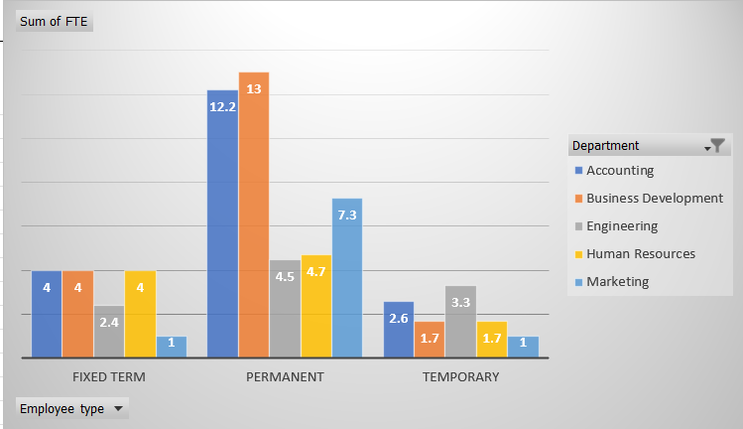
2.BAR DIAGRAM:

Slide 15
Conclusion:
Analyzing employee performance based on departments, employee type, and Full-Time Equivalent (FTE) using Excel provides crucial insights into workforce dynamics and organizational efficiency. By breaking down performance metrics across different departments, it becomes easier to identify areas of strength and those needing improvement. Evaluating employee types-such as full-time, part-time, and contract workers-helps in understanding their respective contributions and informs decisions on hiring and resource allocation. Additionally, analyzing performance in relation to FTE allows for a fair comparison across employees with varying workloads, ensuring a balanced assessment of productivity. Excel's powerful tools, such as pivot tables and charts, make it easy to visualize these insights, enabling data-driven decision-making that can lead to enhanced organizational performance and better strategic planning.

